Slide 1
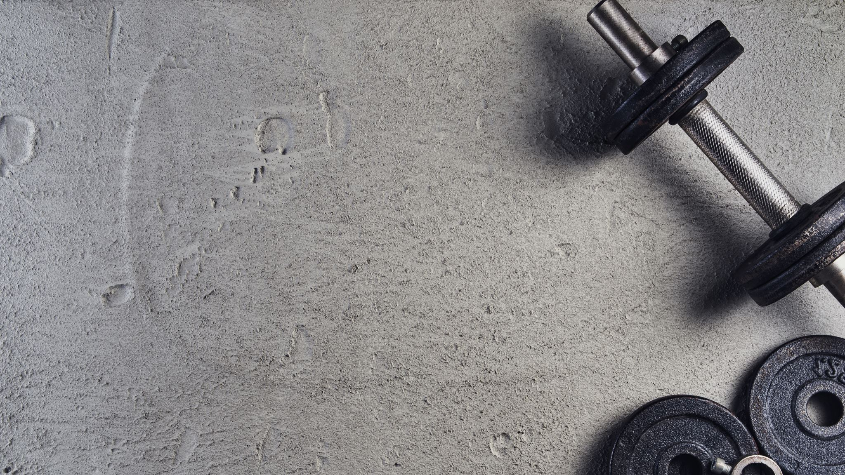

Distributed System Research Laboratory Fitness Tracking Application
Technical University of Cluj-Napoca
Faculty of Computer Science and Automation
Department of Computer Science
Student: Horia-Andrei Moldovan
Supervisor: Lecturer Dr. Eng. Marcel Antal
Consultant: Prof. Dr. Eng. Ioan Salomie
Cluj-Napoca, Romania

Slide 2
Contents
Context and motivation
Objective
Related work
Solution
Implementation
Experimental Results
Conclusion
Bibliography

Slide 3
Context and Motivation
Obesity rate continuously increases – WHO[40%}.
Lack of physical activity leads to health issues – NINDS[80%}.
Use this era of digitalisation in our advantage.

Slide 4
Objective
Main Objective
Study, design and implement a fitness tracking application capable of helping the users increase their overall performance and achieve specific goals. Provide functionalities which can present the road to becoming a better self as something which anyone can achieve.
Secondary Objectives
Study already existing approaches.
Create features which are able to track not only the physical activities but also the diet status on a daily basis.
Come with the best solution for repetition counting by analyzing various smartwatch signals.
Provide accurate graphs and suggestive feedbacks which help the user monitor his improvements.
Provide an interactive graphical user interface.

Slide 5
Related work
Application | Repetition Counting | Personalized Diet | Workout feedback+download | Personal Records | Exercise Info | Community | Personalized Workouts
FitNotes | ❌ | ❌ | ✓ | ❌ | ✓ | ❌ | ❌
Workit | ❌ | ❌ | ❌ | ❌ | ✓ | ✓ | ✓
Stacked | ❌ | ❌ | ✓ | ✓ | ✓ | ❌ | ✓
FitBit | ❌ | ✓ | ❌ | ❌ | ✓ | ❌ | ✓
GamesBeat | ✓ | ❌ | ✓ | ❌ | ❌ | ❌ | ✓
MyApp | ✓ | ✓ | ✓ | ✓ | ✓ | ❌ | ❌

Slide 6
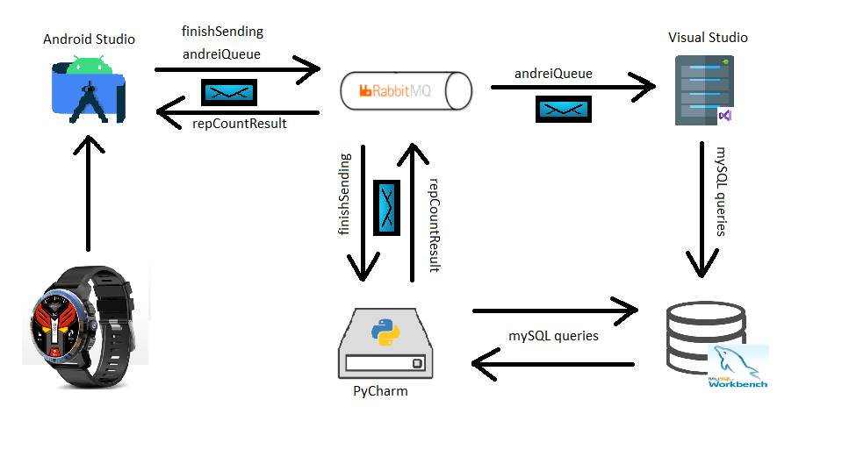
Solution - Architecture
A smartwatch application capable of assisting the user, through its functionalities, during his workout as well as throughout the entire day.
Design functionalities which help the user track not only physical activities but also the daily diet.

Slide 7
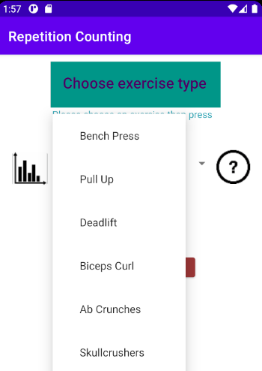
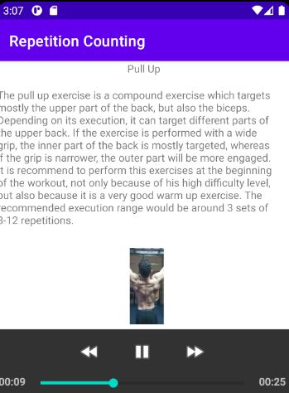
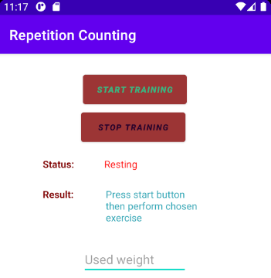
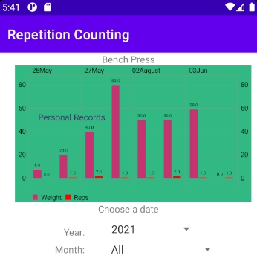
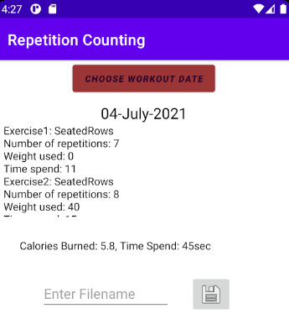
Solution – Physical activities
Functionalities
Exercise info
Repetition count
Personal records visualisation
Post workout description and feedback

Slide 8
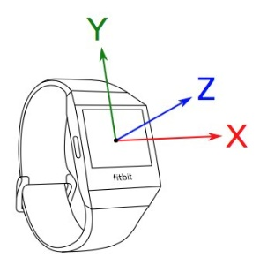
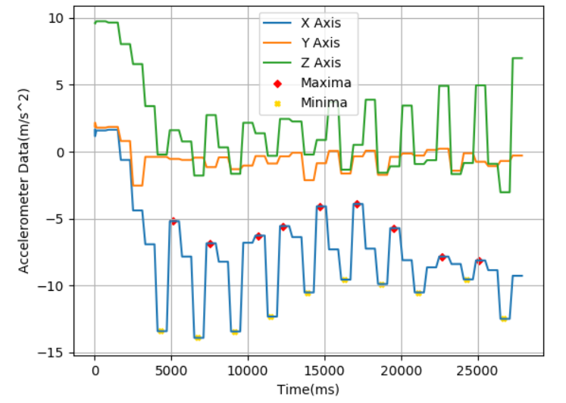
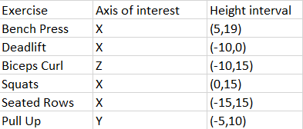
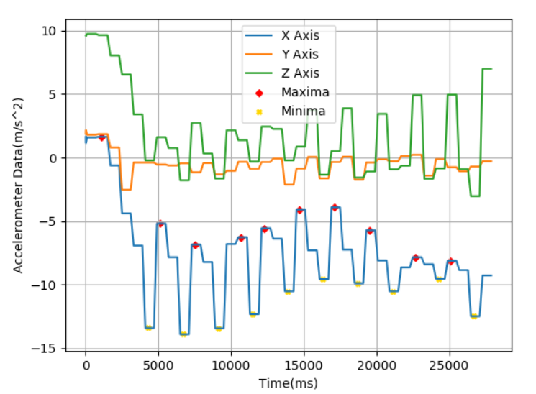
Solution – Repetition Counting
Signal capturing – 3-axis accelerometer [1]
Approach used – supervised data gathering[2]
Method used – counting signal peaks
Different exercise -> different approach
Example – Deadlift signal

Slide 9
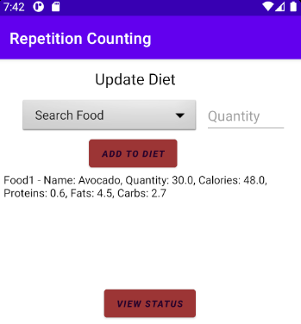
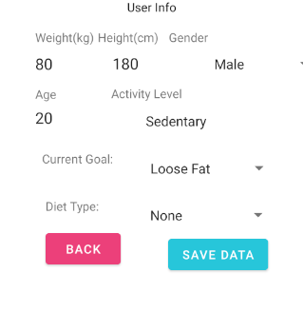
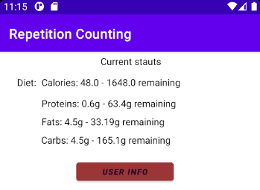
Solution - Diet
Functionalities
Add dishes to diet
Customize current diet
Real time feedback

Slide 10
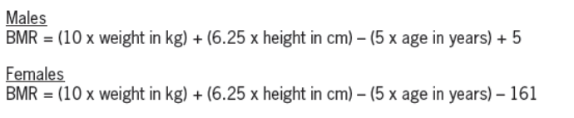

Solution - Formulas
Diet
Physical Activity
TDEE = BMR * Activity Level
Activity Level | Multiplicity factor
Sedentary | 1.2
Slightly active | 1.4
Moderately active | 1.6
Very active | 1.75
Extremely active | 2.0
Professional athlete | 2.3
Exercise | MET
Bench Press | 6.3
Seated Rows | 6
Deadlift | 6.5
Triceps Pushdown | 5.9
Biceps Curl | 5.9

Slide 11
Implementation - Components
In order to implement the full design, the following concepts have been used.
Technology | Programming Language | Use
Android Studio | Kotlin | Design + Controller
PyCharm | Python | Complex computations
Visual Studio | .Net | Store into database
MySql Workbench | SQL | Central storing place
CloudAMQP | - | Communication between applications

Slide 12
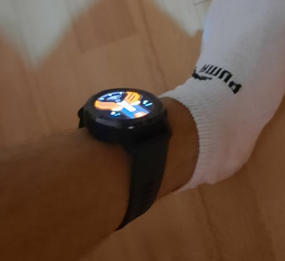
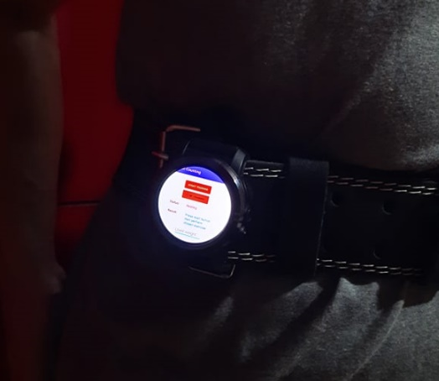
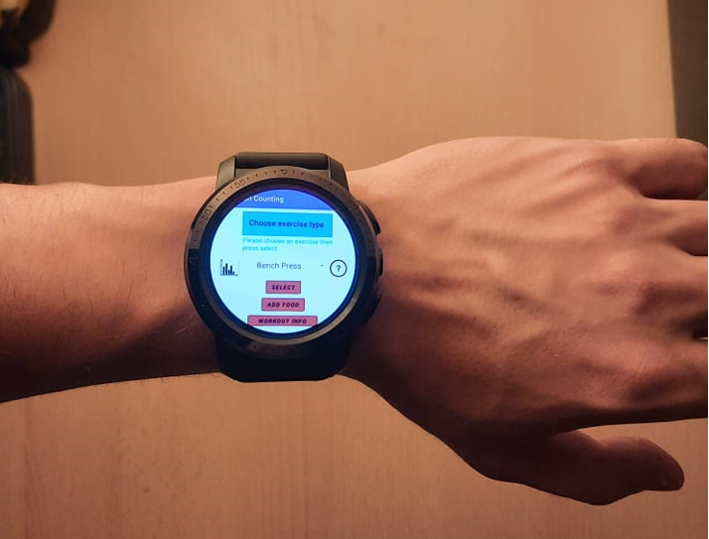
Experimental Setup
Install android application on Kospet Optimus Prime smartwatch
Provide a working internet connection
Place the smart device in the appropriate place [3]

Slide 13
Experimental Results
Exercise | Number of executions | Number of people | Accuracy at Home | Accuracy at Gym
Bench Press | 10 | 5 | 84% | 96%
Pull Up | 6 | 2 | 95% | -
Seated Rows | 10 | 5 | 88% | 94%
Biceps Curls | 10 | 5 | 80% | 85%
Squats | 6 | 2 | 92% | -
Deadlifts | 6 | 2 | 96% | -
Lateral Raises | 10 | 5 | 76% | 72%
Lat Pulldowns | 10 | 5 | 87% | 94%
Leg Extension | 5 | 1 | - | 78%

Slide 14
Conclusion
A distributed system for tracking the physical exercise along with the daily diet was implemented.
A method for accurately counting the number of performed repetitions was created.
An user interface covering all the presented functionalities.

Slide 15
Bibliography
[1] Andrea Soro, Gino Brunner, Simon Tanner, and Roger Wattenhofer. Recognition and repetition counting for complex physical exercises with deep learning. Sensors, 19:714, 02 2019.
[2] Bobak Mortazavi, Mohammad Pourhomayoun, Gabriel Alsheikh, Nabil Alshurafa, Sunghoon Lee, and Majid Sarrafzadeh. Determining the single best axis for exercise repetition recognition and counting on smartwatches. pages 33–38, 06 2014
[3] Oresti Banos, M´at´e T´oth, Miguel Damas, Hector Pomares, and Ignacio Rojas. Dealing with the effects of sensor displacement in wearable activity recognition. Sensors (Basel, Switzerland), 14:9995–10023, 06 2014.

Slide 16
Thank You!

Slide 17
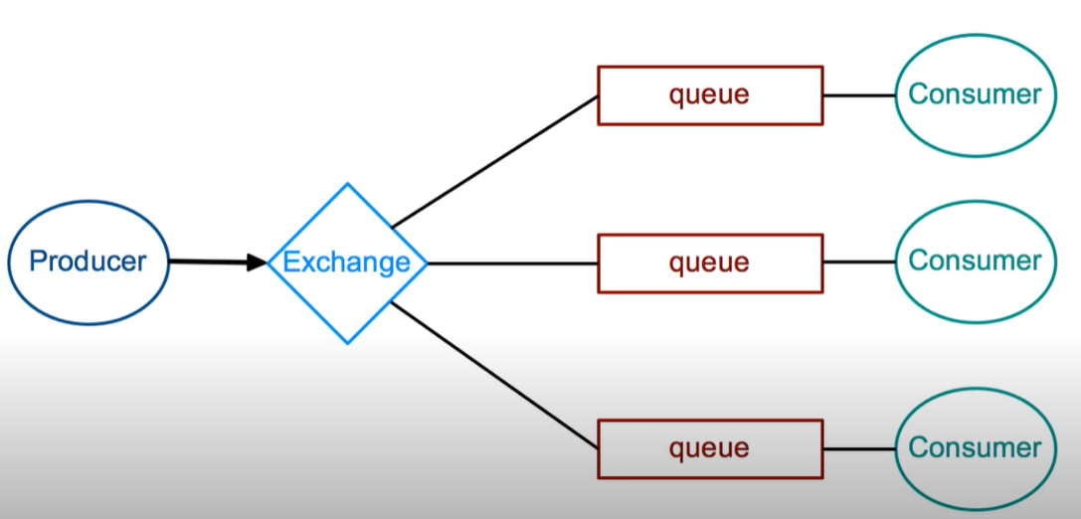
RabbitMq - Functioning

Slide 18
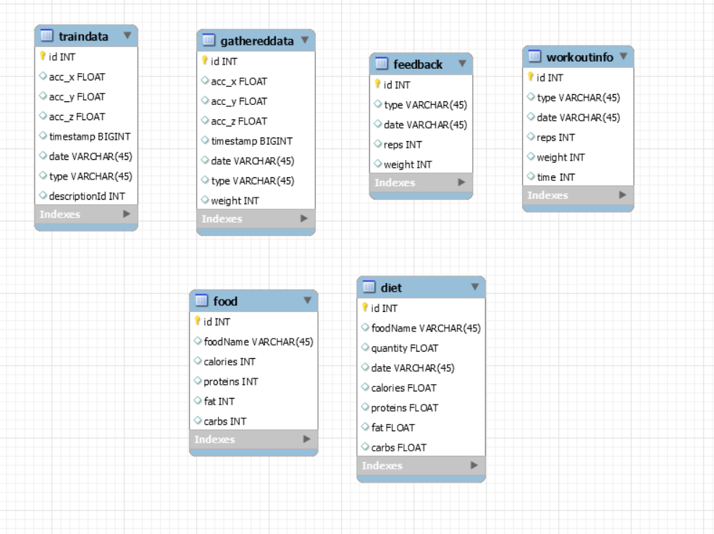
Database - architecture

